Slide 1


Unit 1 – What is IoT?

Slide 2
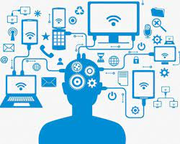
Unit Goal
This unit aims to introduce the students to IoT Technologies.
At the end of this unit, students will be able to recognize the main IoT concepts.

Slide 3
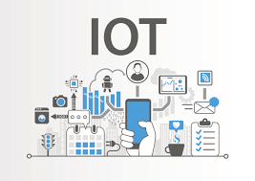
Talking a little about the Course Methodology

Slide 4






Competence-Based Learning
Critical Thinking & Problem-solving Skills
Sustainability
Ethics and Citizenship
Innovative Entrepreneurship
Digital Transformation

Slide 5
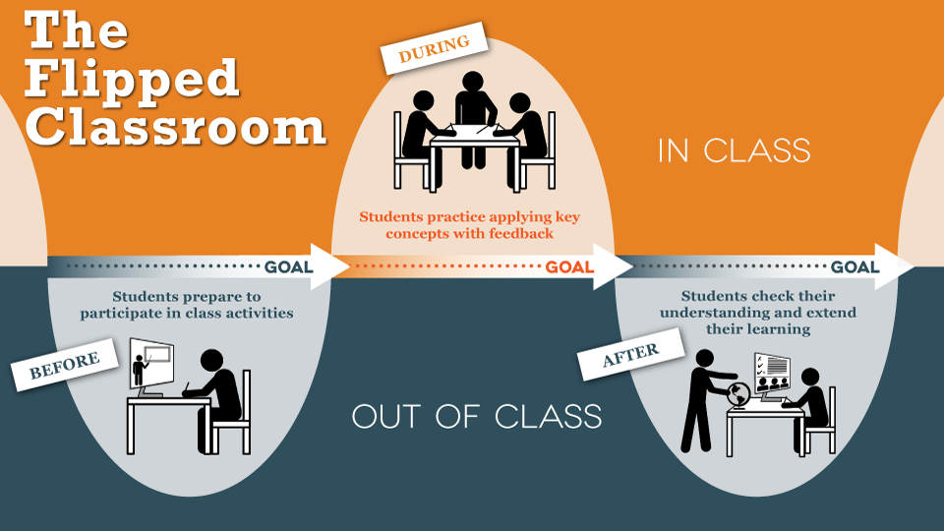

Slide 6
What is the Internet of Things (IoT)?

Slide 7

IoT Applications
https://www.youtube.com/watch?v=91aXs9E0qAI

Slide 8
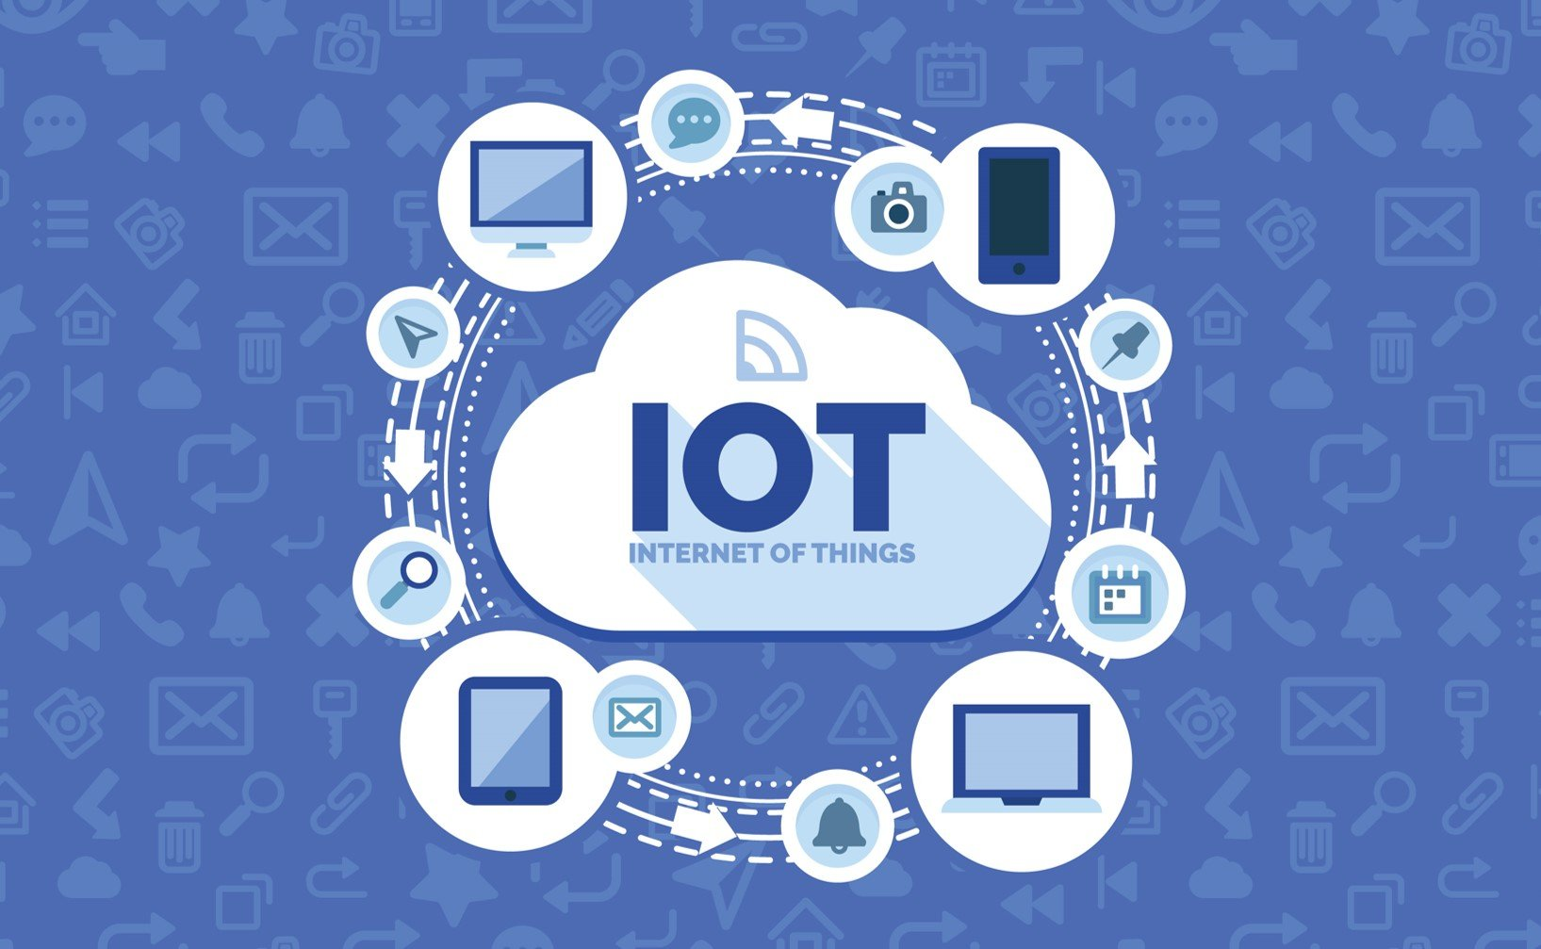
What is the Internet of Things (IoT)?
… describes the network of physical objects (things) that are embedded with sensors, software, and other technologies to connect and exchange data with other devices and systems over the internet.

Slide 9
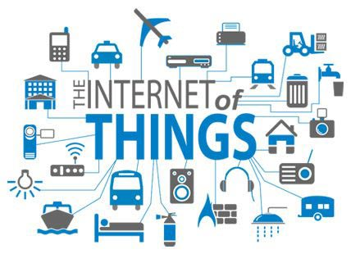
What is Thing?
A thing can be a person with a heart monitor implant, a farm animal with a biochip transponder, an automobile that has built-in sensors to alert the driver when tire pressure is low, or any other natural or man-made object that can be assigned an Internet Protocol (IP) address and can transfer data over a network.

Slide 10
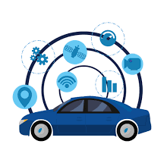

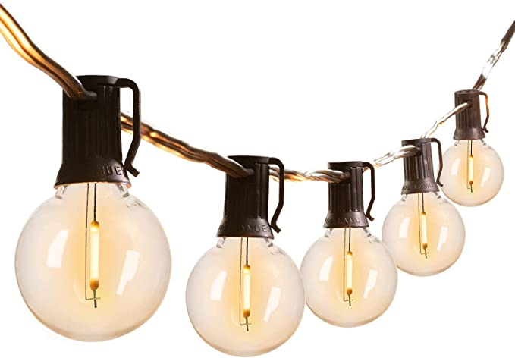

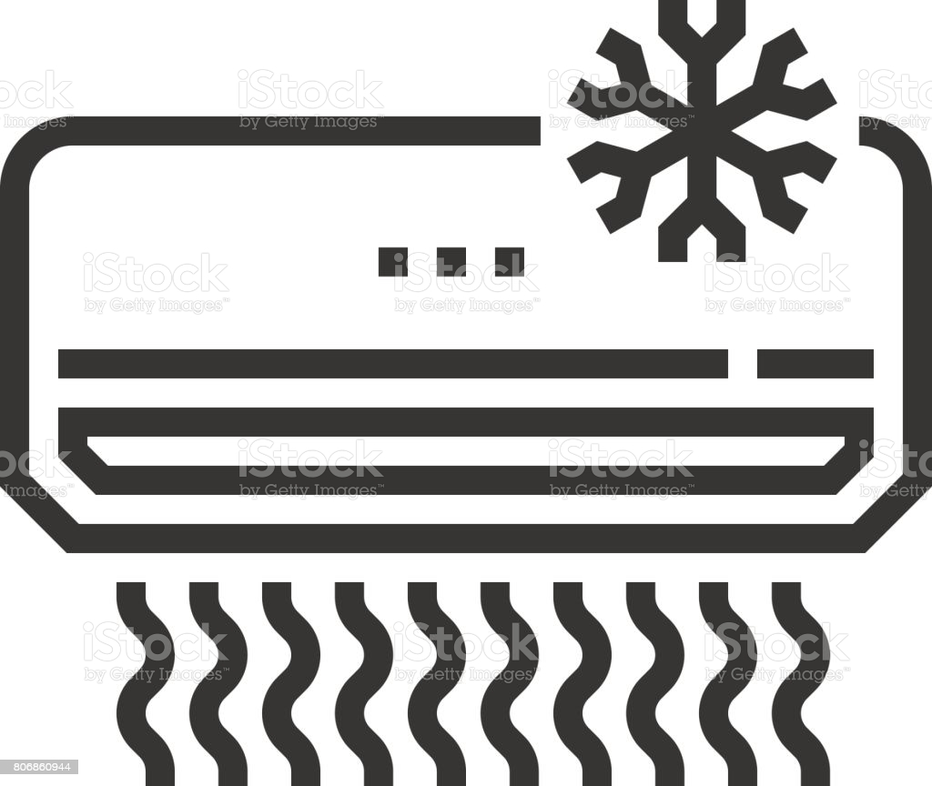
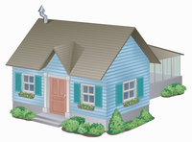


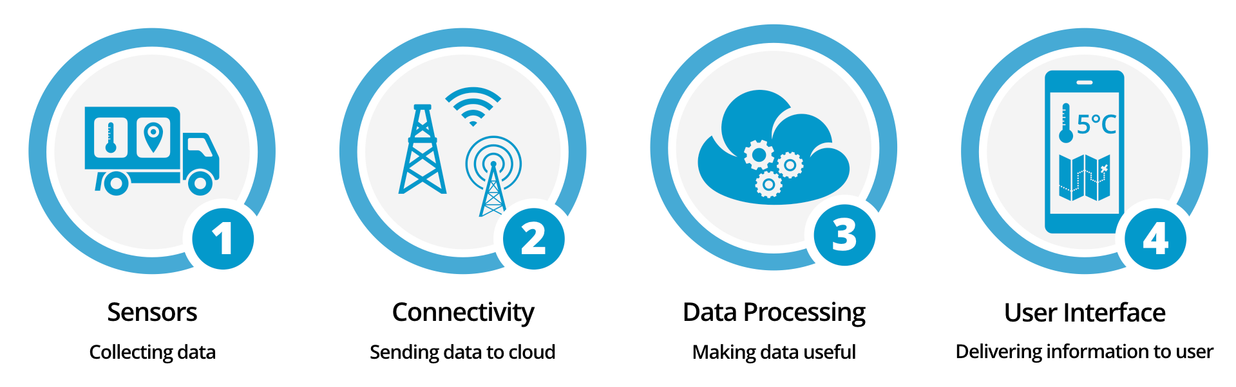
Internet of Things (IoT) Ecosystem

Slide 11
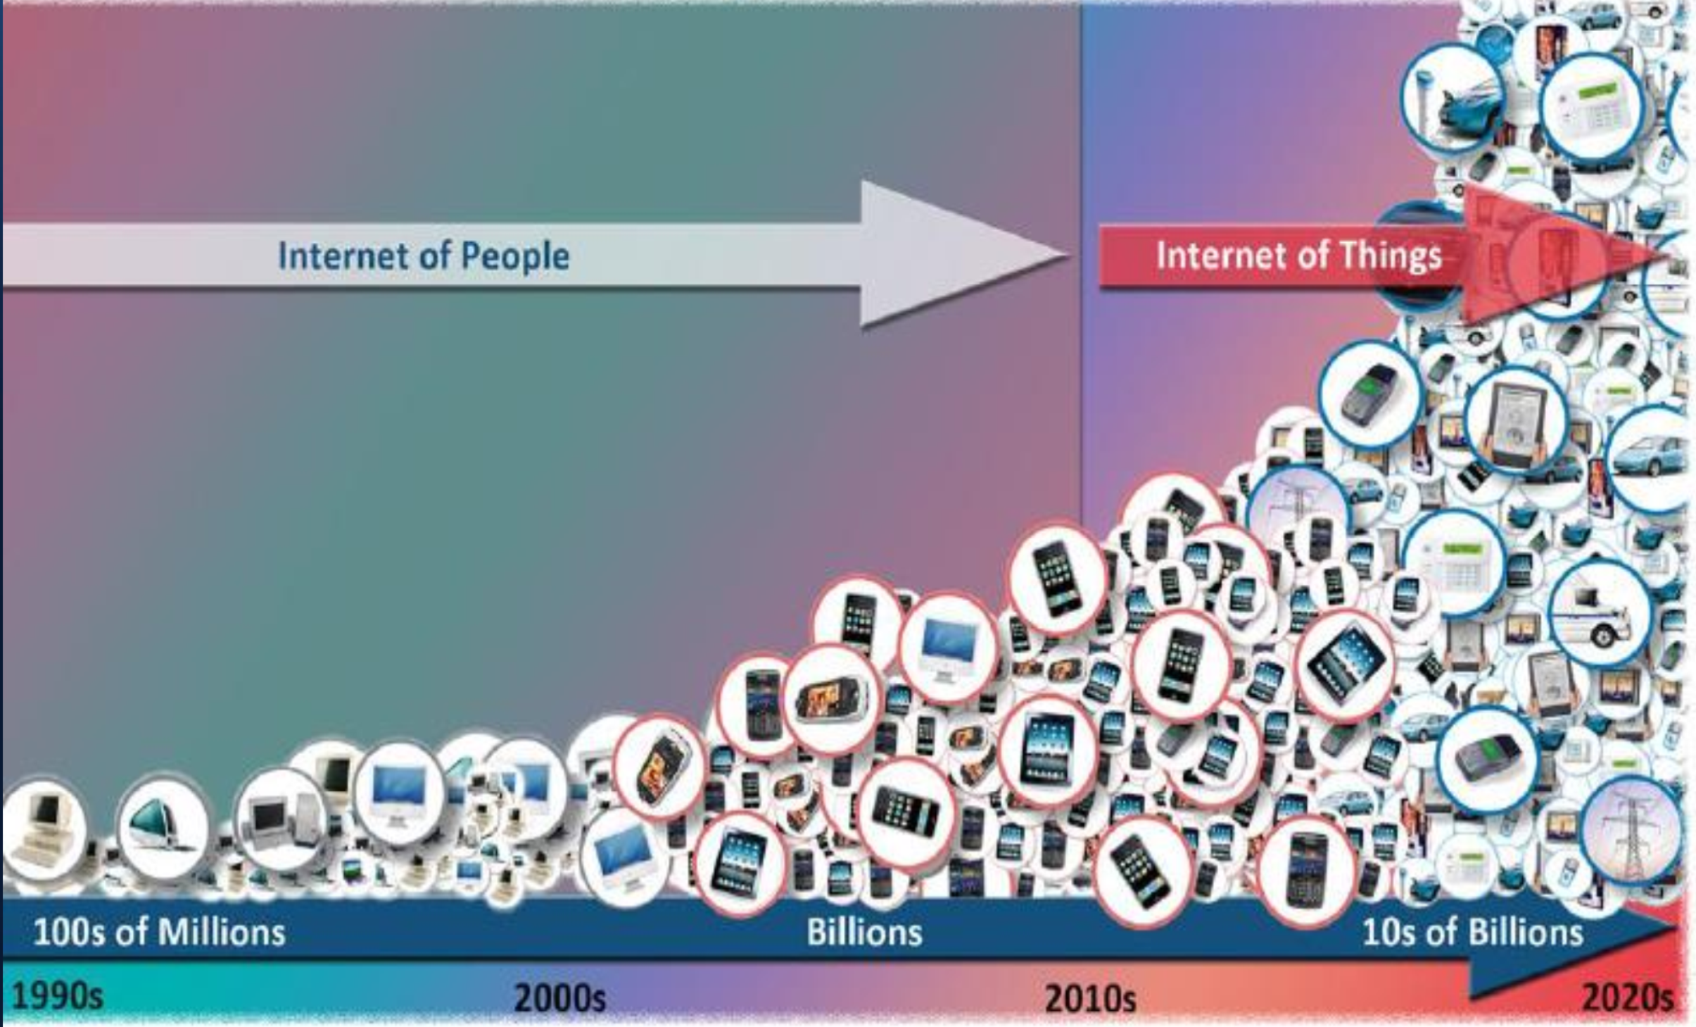
What is Internet of Things (IoT)?
IoT Question

Slide 12

IoT Question
Expanding Interdependence of Humans
to
INTERACT
CONTRIBUTE
& COLLABORATE
to
THINGS

Slide 13
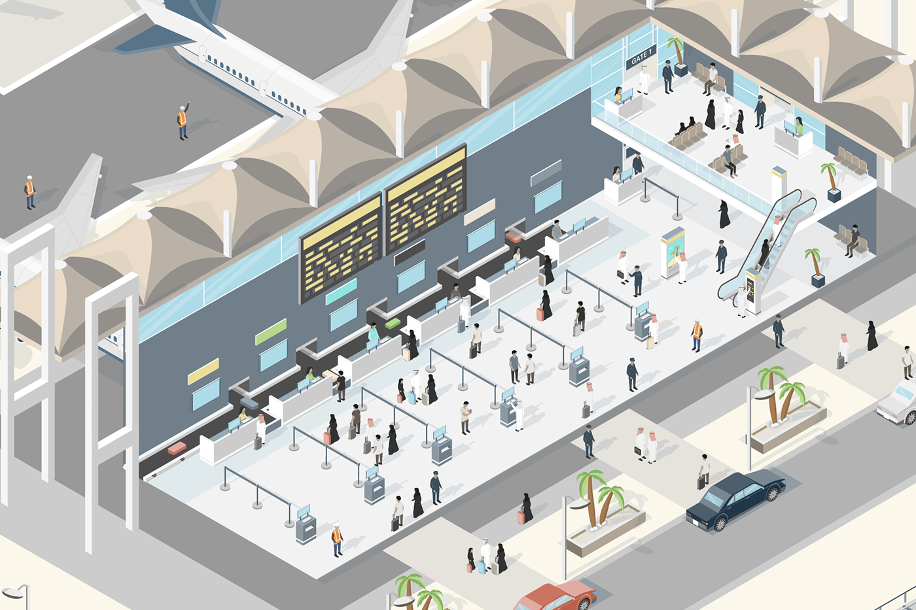
Benefits
Efficient Resource Utilization
Minimizing Human Effort
Development of AI through IoT
Saves Time

Slide 14
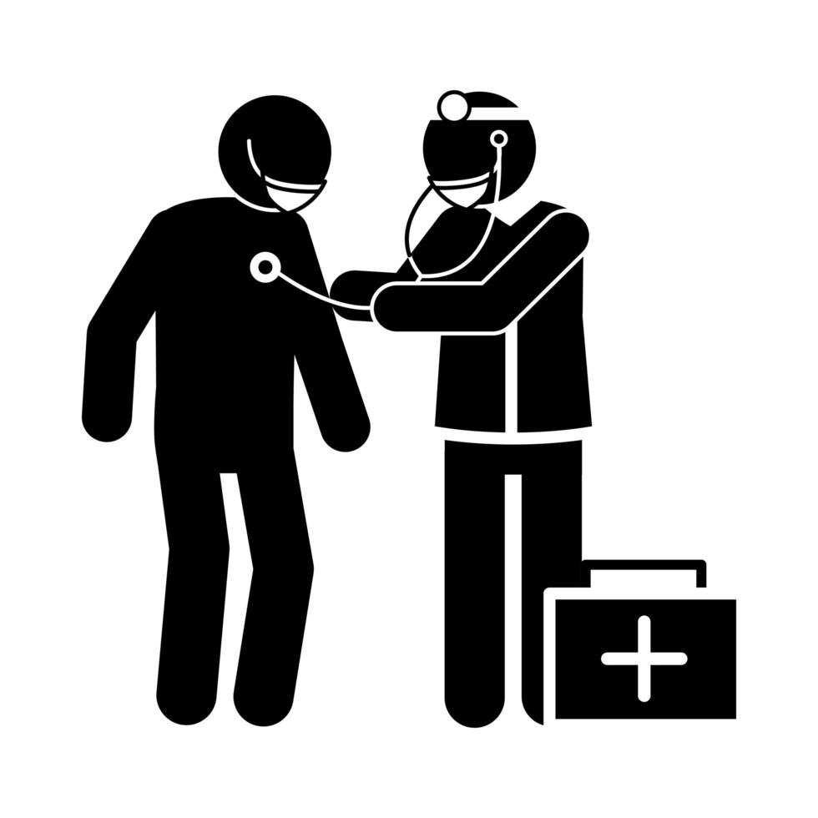




IoT Application Example
Prescription
Medicines
Before the ambulance arrives, the facility receives the required information to be prepared based on the reports.
Resource Allocation

Slide 15
How does IoT work?

Slide 16
How does IoT work?
Collects data using various type of sensors
Filter & summarize data before sending it on network
Perception
Pre-processing
Creates abstraction such as hiding hardware details
Different entities communicate over network using different protocols & standard
Communication
Middleware
Various application that improves user experience & increases efficiency
Applications

Slide 17
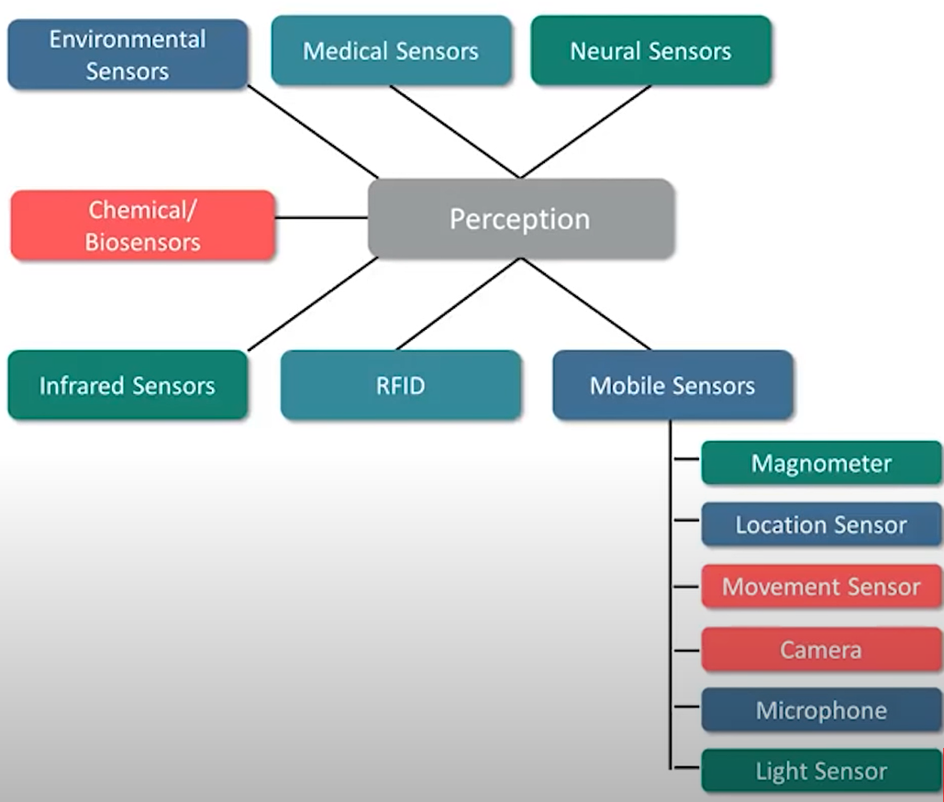
Perception
IoT applications need one or more sensors to collect data from the environment
Sensors are small, low-cost, and consumes low energy
Various type of sensors are used in building smart applications

Slide 18
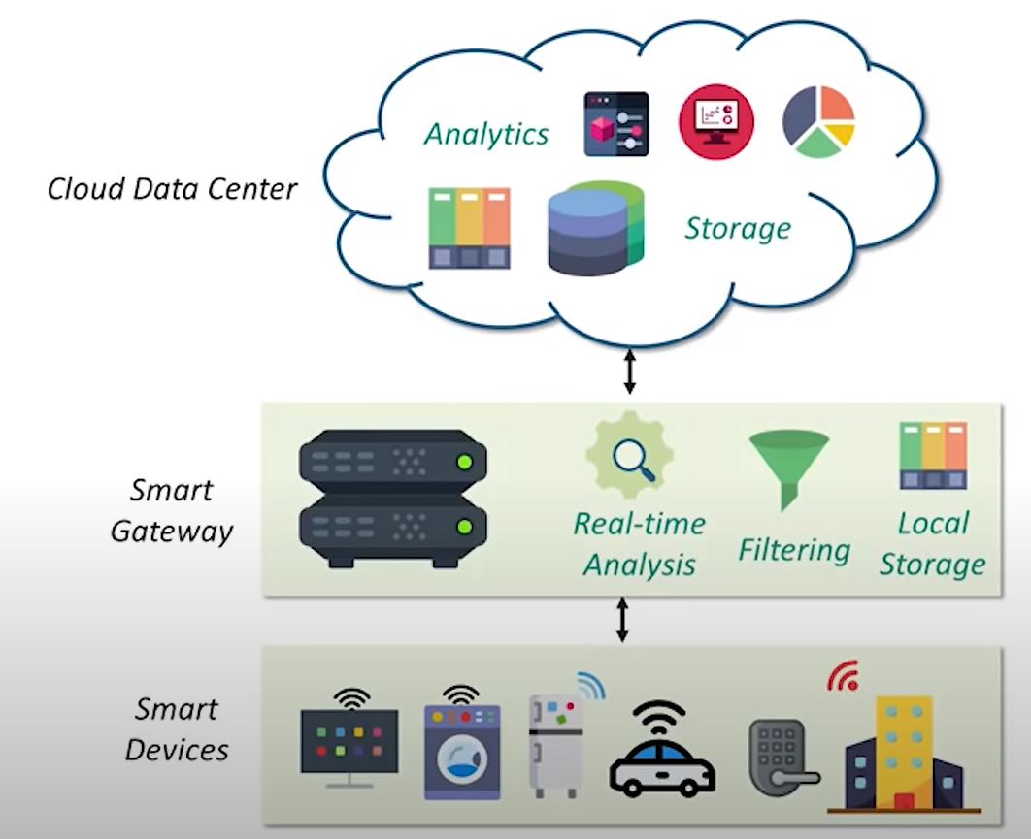
Pre-processing
Mobility: smart devices are mobile & changing network conditions makes communication difficult
Reliable & real-time actuator: latency sensitive applications need real-time responses
Scalability: multiple devices increases the latency
Limitations of processing in the cloud

Slide 19
Pre-processing
Low latency: less time required to access computing or storage resources
Distributed Nodes: fog nodes are distributed, which provide services to mobile services
Mobility: smart devices can communicate to smart gateway present in the proximity
Real-time response: applications with high latency requirements receive real-time response from fog nodes
Interaction with cloud: the data which needs high processing is sent to cloud
Features of Fog Computing

Slide 20
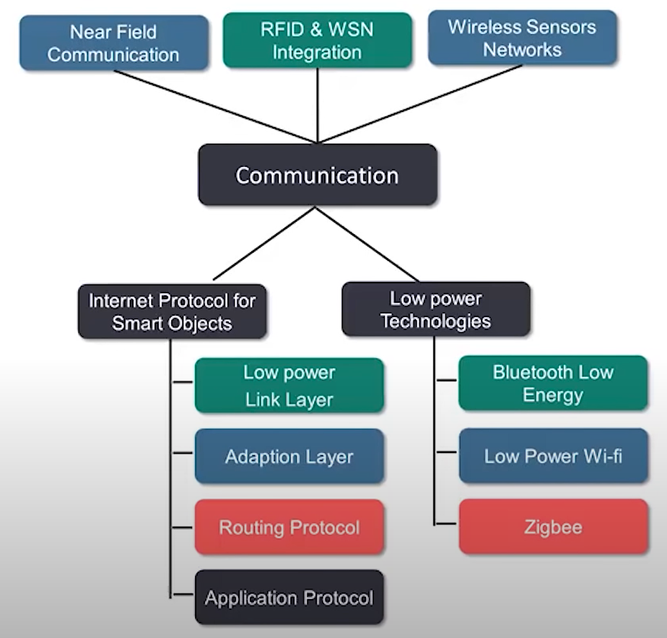
Communicating
Addressing & Identification: Limitations of processing in the cloud each smart device needs to be identified with a unique address in the network
Low Power Communication: communication between devices needs to be low-power consuming
Routing protocol with low memory requirement & efficient communication protocol
High speed & lossless communication

Slide 21
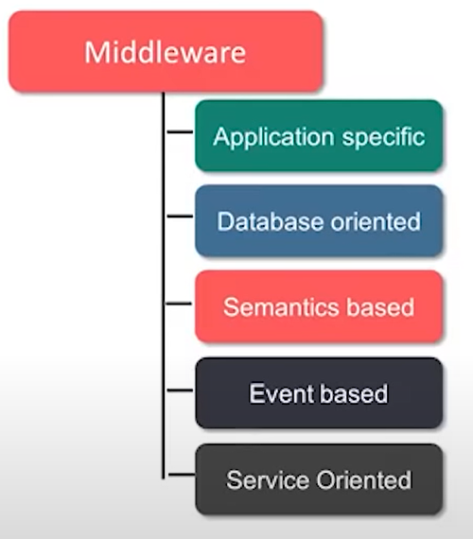
Middleware
Interoperability & Programming abstraction
Device discovery & management
Scalability
Big Data Analytics
Security & Privacy
Cloud services
Context detection

Slide 22
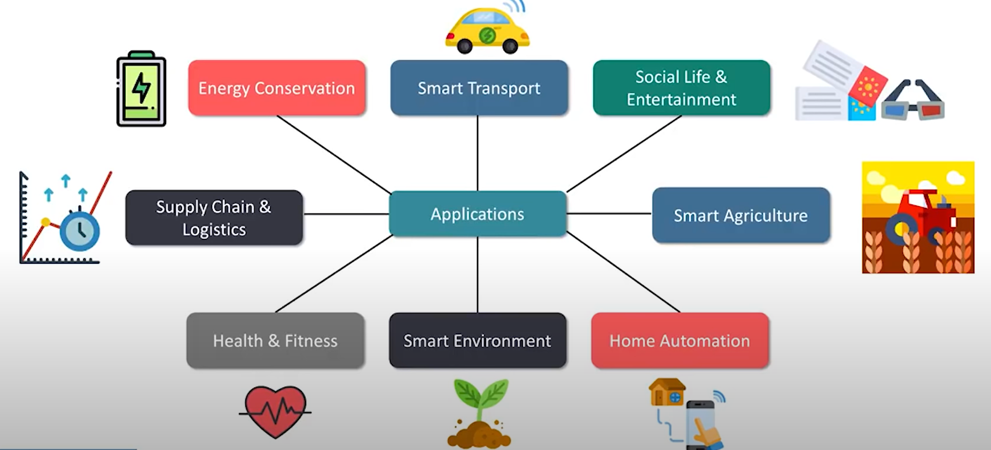
Applications

Slide 23
IoT Applications

Slide 24
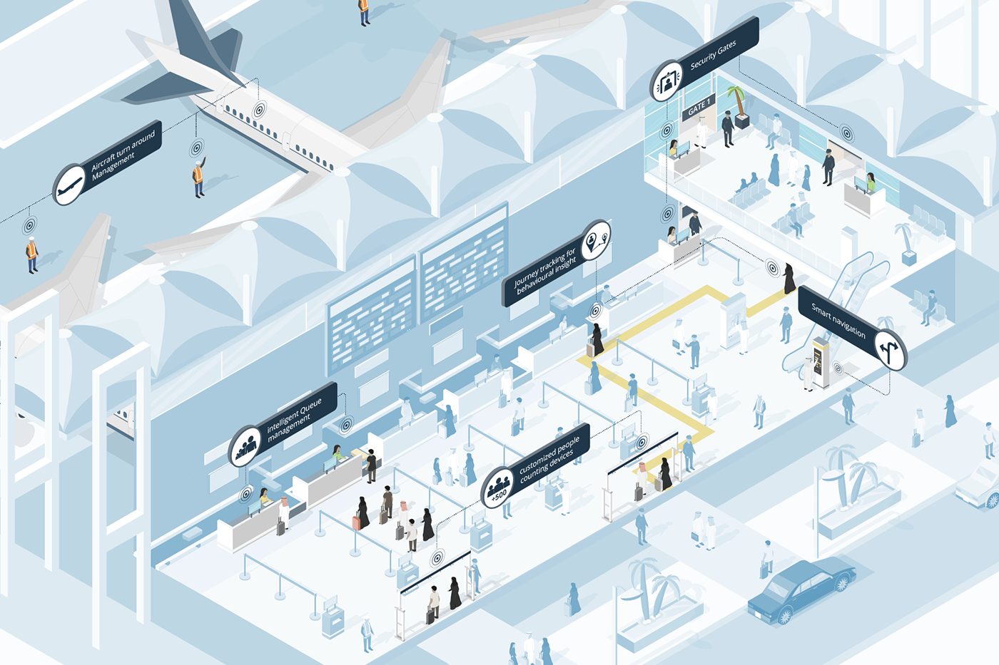
Airport Applications Saudi Arabia Smart Airport

Slide 25
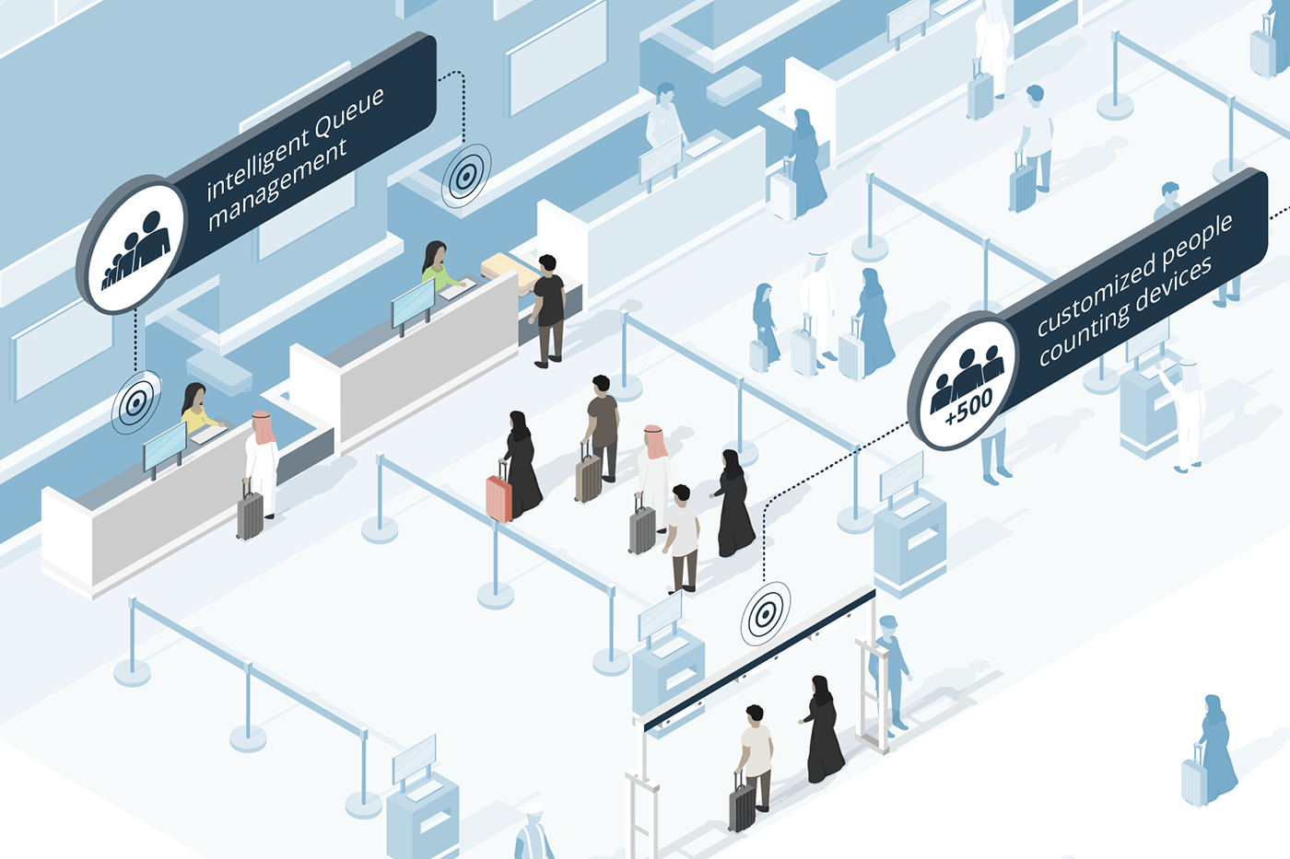
Intelligence Queue Management
Customized People Counting Device

Slide 26
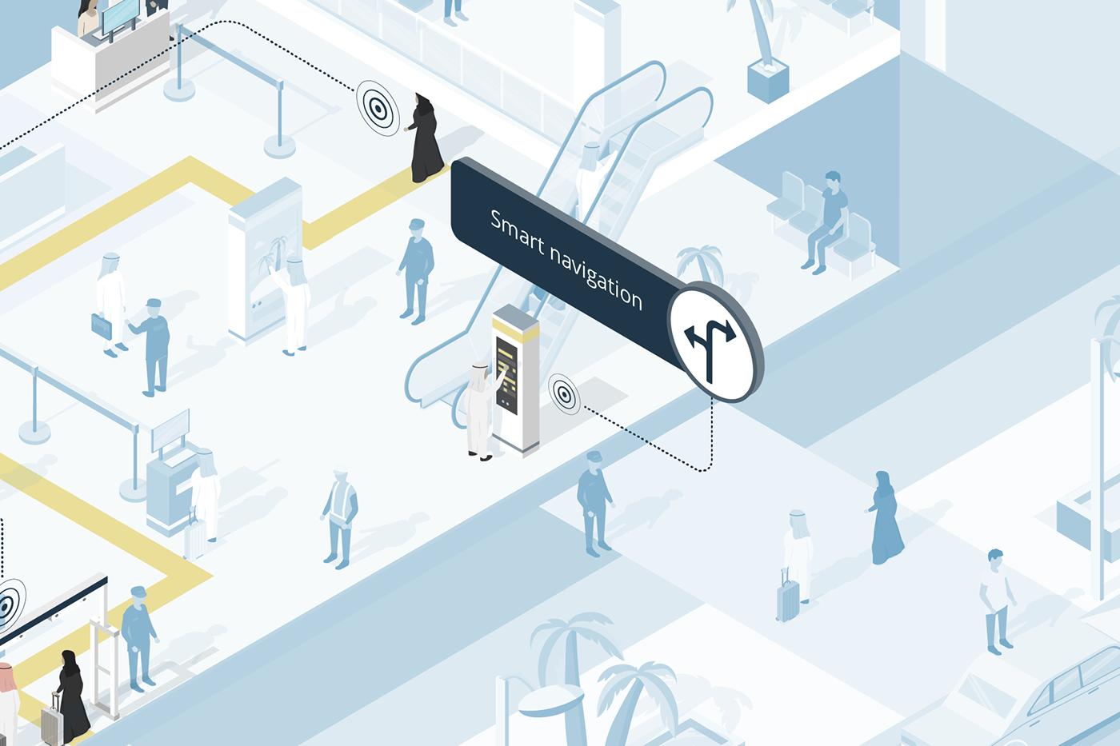
Smart Navigation

Slide 27
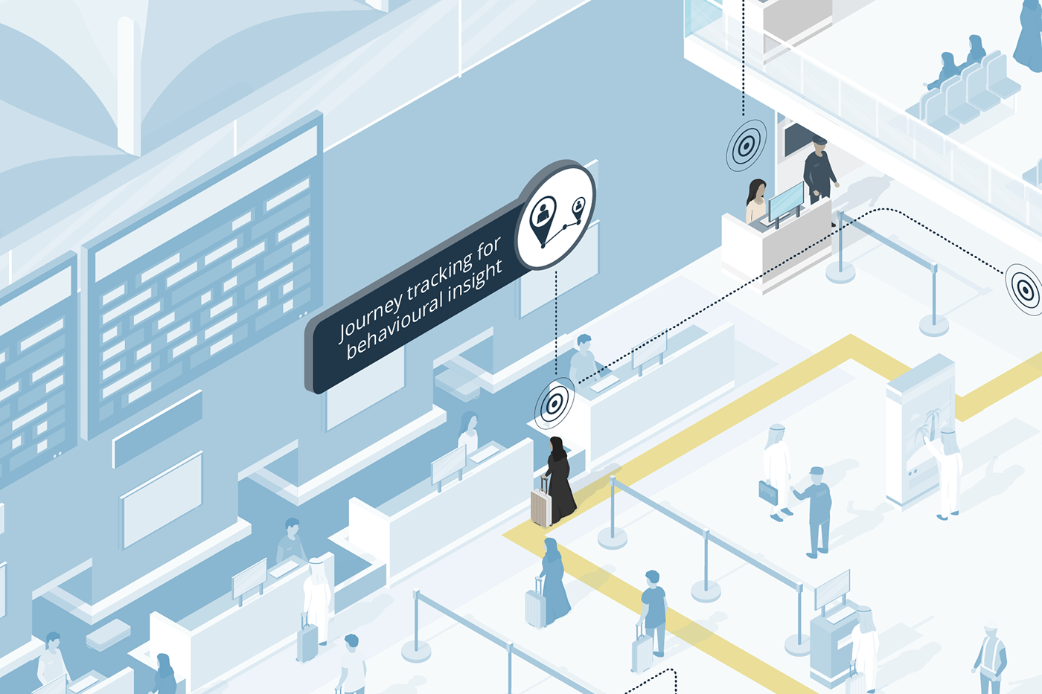
Journey Tracking for Behavioral Insight

Slide 28
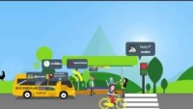
A School Day With IoT
https://www.youtube.com/watch?v=wrGPPT-gxjw

Slide 29
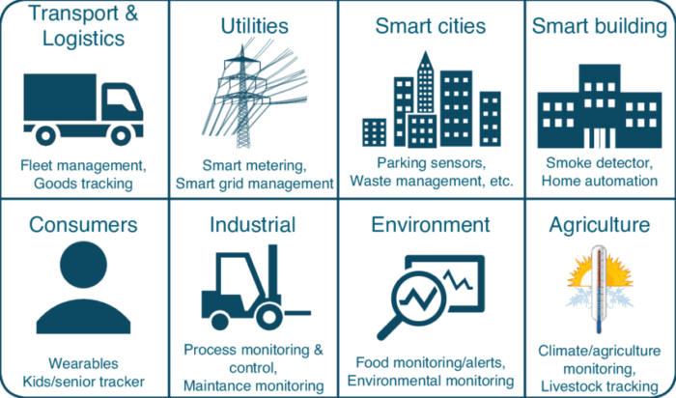

Slide 30
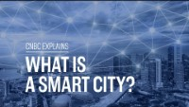
What is a smart city? | CNBC Explains
https://www.youtube.com/watch?v=bANfnYDTzxE

Slide 31
Unit Goal
This unit aims to introduce the students to IoT Technologies.
At the end of this unit, students will be able to recognize the main IoT concepts.

Slide 32




Homework
Workgroup: Organize using groups of five students
Read: Cisco IoT Customer Stories
https://www.cisco.com/c/en/us/solutions/internet-of-things/resources/case-studies.html
Present: Prepare three slides (show the selected case, how IoT was used in the case, benefits) and speak to your friends (max. five minutes).

Slide 33
Unit 1 – What is IoT?

